Slide 1


Lessons Learned from
Current Measurements with
TerraSAR-X and TanDEM-X
– 2018 Edition –
Roland Romeiser
Rosenstiel School of Marine and Atmospheric Science
University of Miami
rromeiser@miami.edu
ROLAND ROMEISER LESSONS LEARNED FROM CURRENT MEASUREMENTS WITH TERRASAR-X & TANDEM-X DOFS 2018 BREST
ROLAND ROMEISER LESSONS LEARNED FROM CURRENT MEASUREMENTS WITH TERRASAR-X & TANDEM-X DOFS 2018 BREST

Slide 2
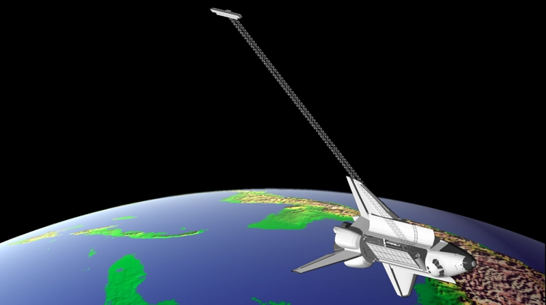
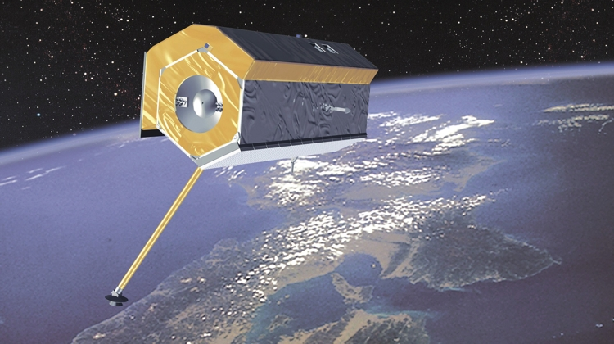
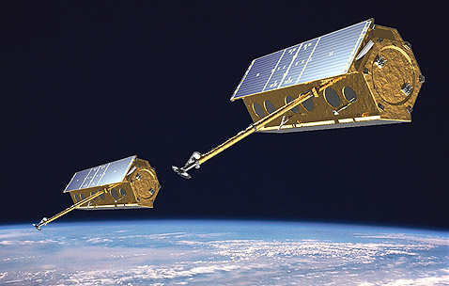
Spaceborne SAR Along-Track Interferometry
●
●
●
● Shuttle Radar Topography Mission (SRTM), February 2000
● TerraSAR-X, launched 2007 (Divided Antenna Modes)
● TanDEM-X, launched 2010

Slide 3
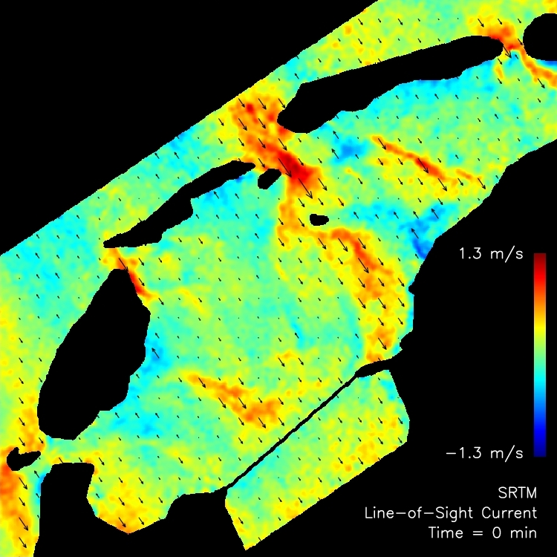
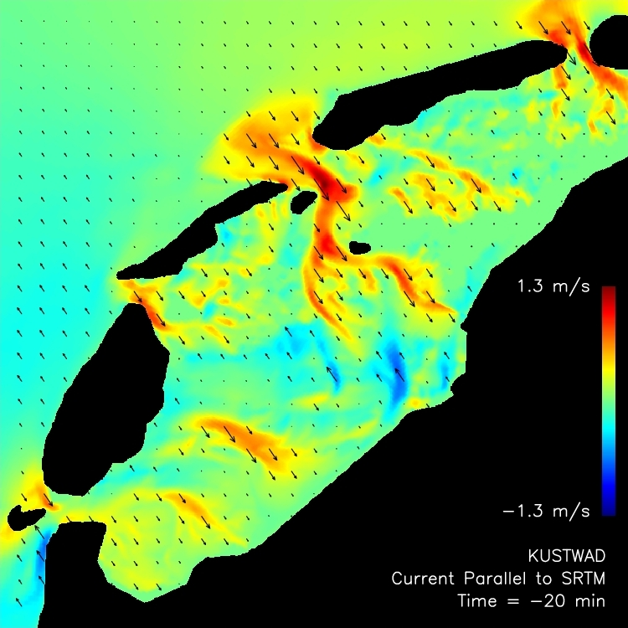
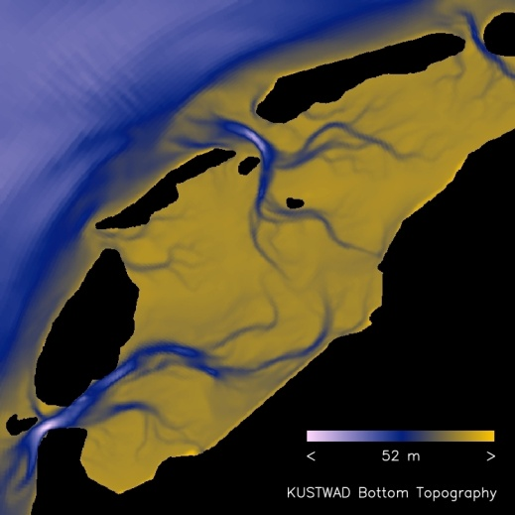
First SRTM ATI Result – Dutch Wadden Sea, Feb 2000
Line-of-sight current from SRTM, (70 km)²
...and from circulation model KUSTWAD
τ = 0.5 ms
Θ = 55°
38.5 m/s / 2π
VV
Bottom topography
●
●
●
● Calibration can be done at coast lines
● Spatially varying wave effects are small
● Accuracy ≈ 0.1 m/s at 1 km resolution
Notes:
<numéro>

Slide 4
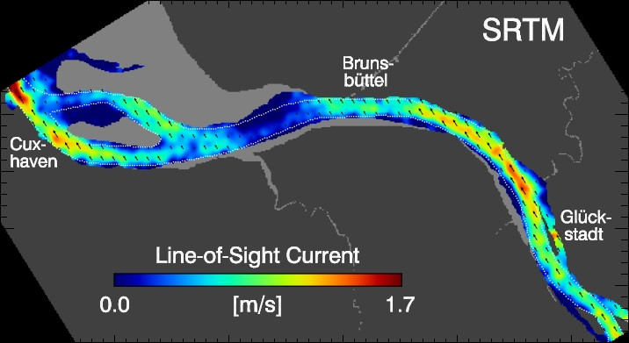
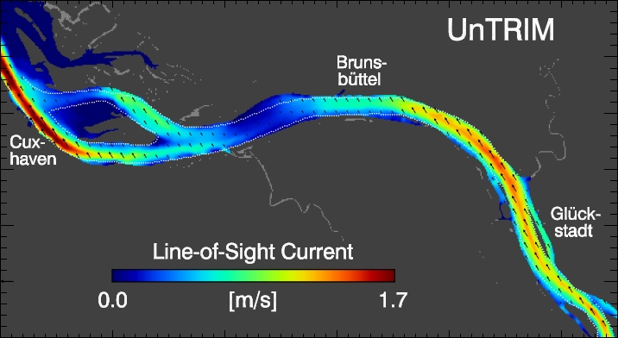
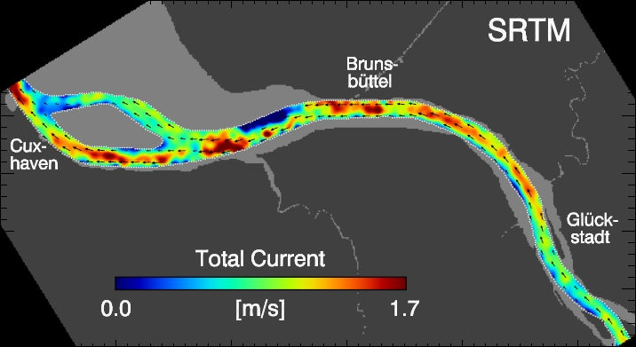
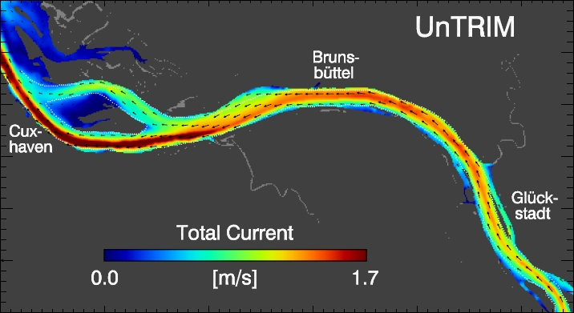
Another SRTM ATI Result – Elbe River
τ = 0.5 ms
Θ = 55°
38.5 m/s / 2π
VV
Line-of-sight current from SRTM
Line-of-sight current from UnTRIM
Total current from SRTM
Total current from UnTRIM
●
● Known flow direction permits total current estimates

Slide 5
First TerraSAR-X ATI Results – Elbe River
Aperture Switching mode, time lag = 0.11 ms, incidence angle = 31°, polarization = VV, area size = 16 km × 25 km

Slide 6
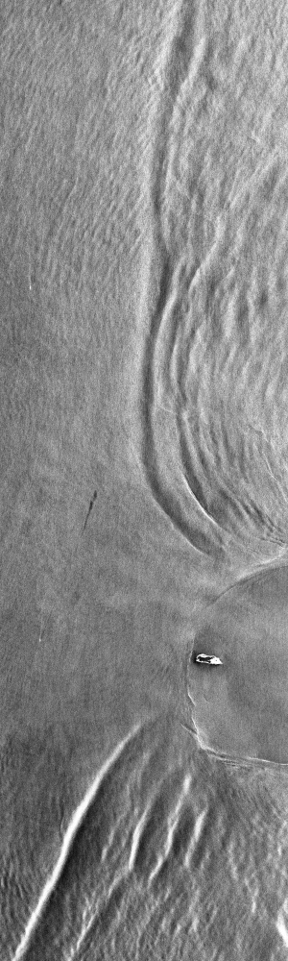

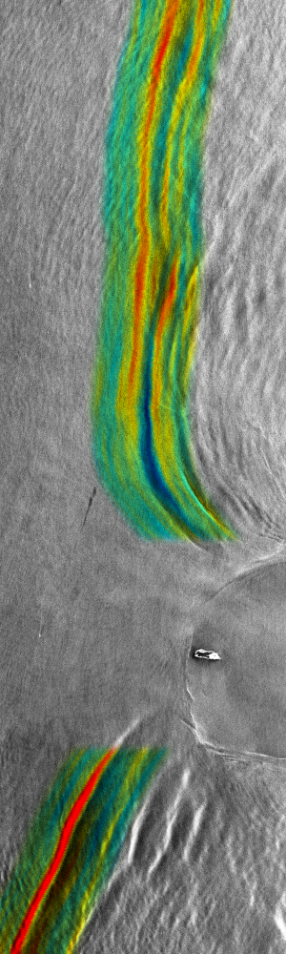
TerraSAR-X DRA Mode – Internal Waves at Dongsha
Time lag = 0.16 ms
Incidence angle = 31°
Polarization = HH
Area size = 30 km × 100 km
8 dB
+1.5°
‒1.5°
⬅
0.5
m/s
0.5
m/s
➔
Amplitude
Phase
Velocity Anomaly

Slide 7
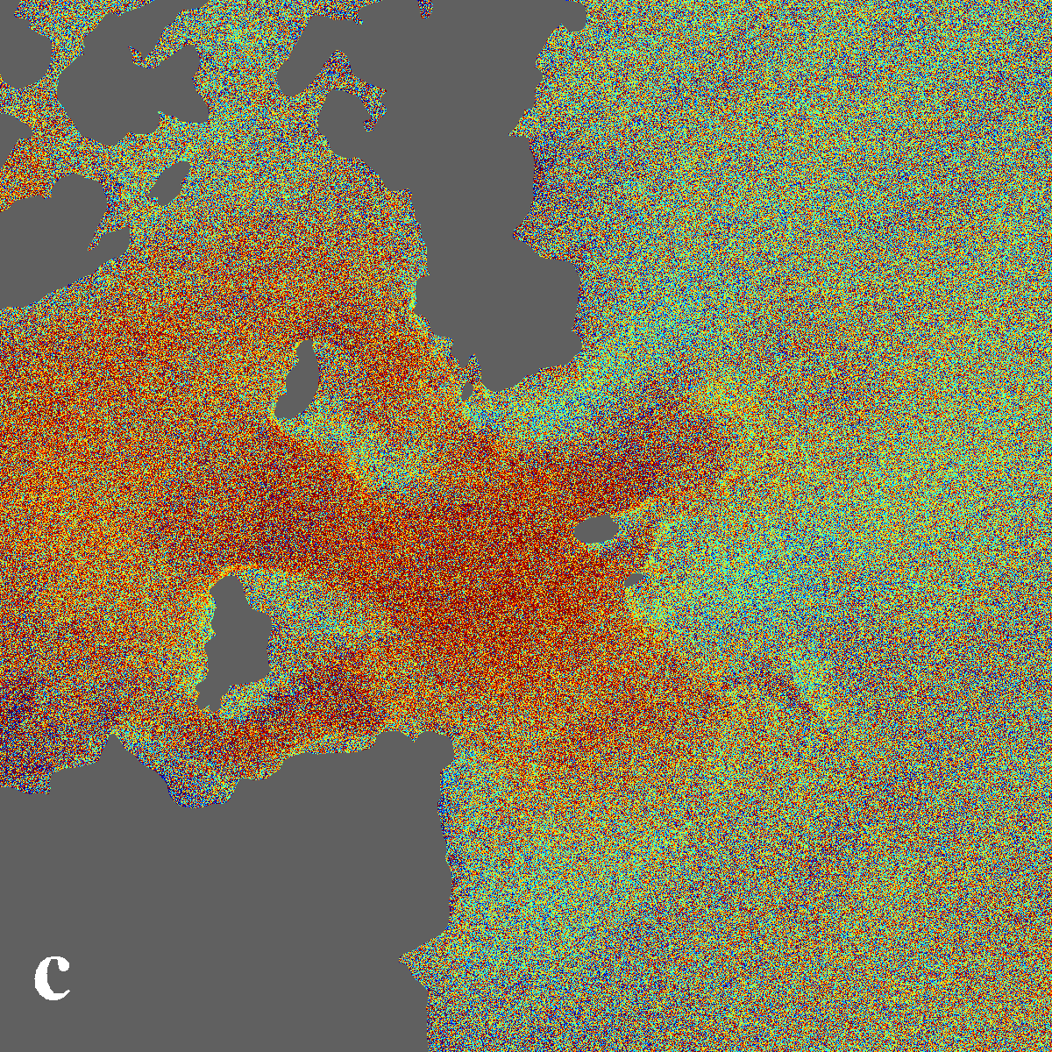
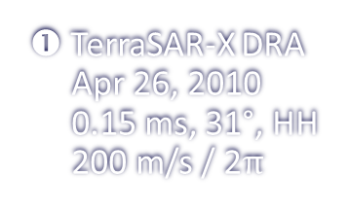
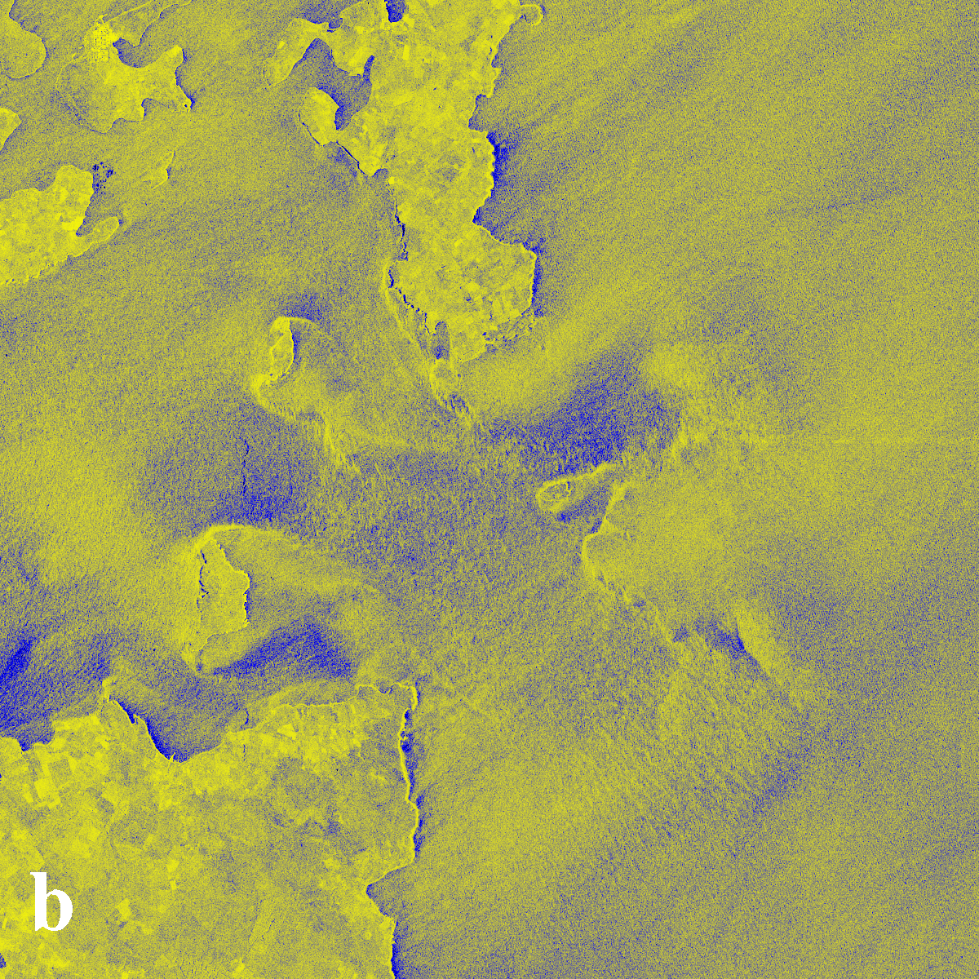
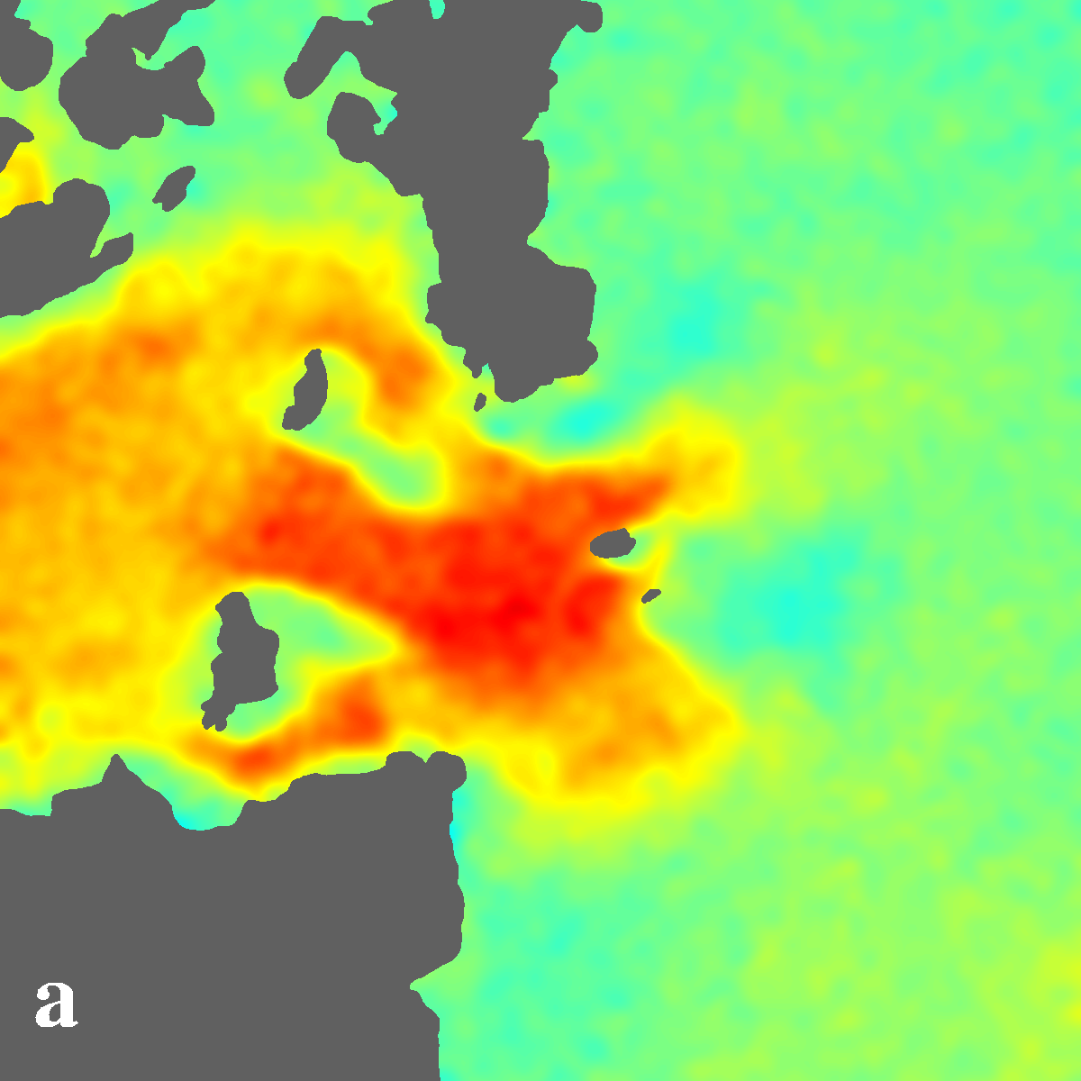
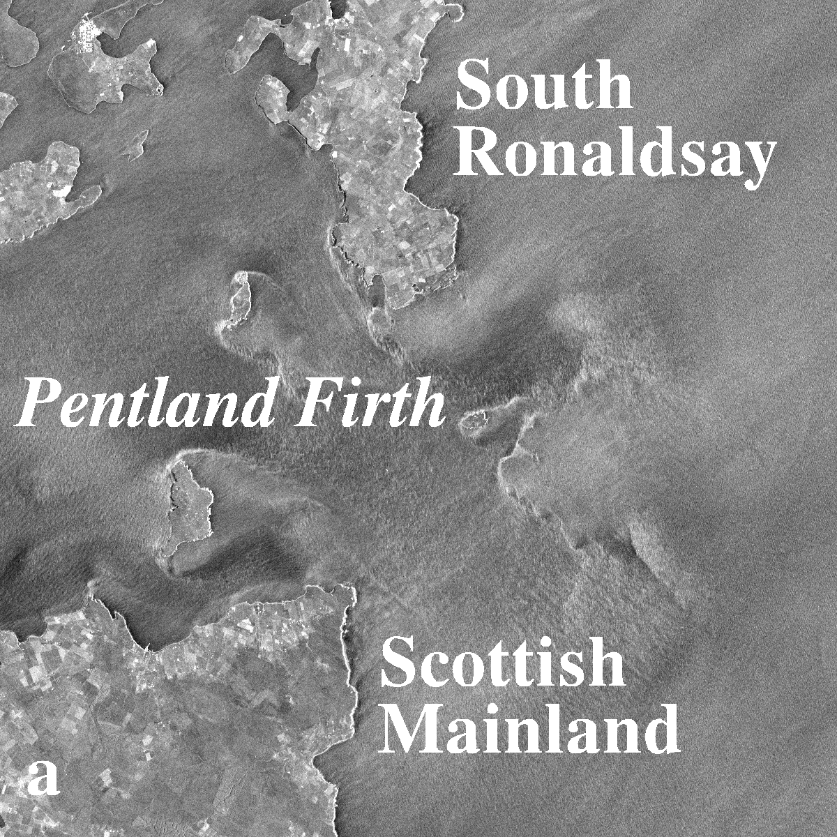
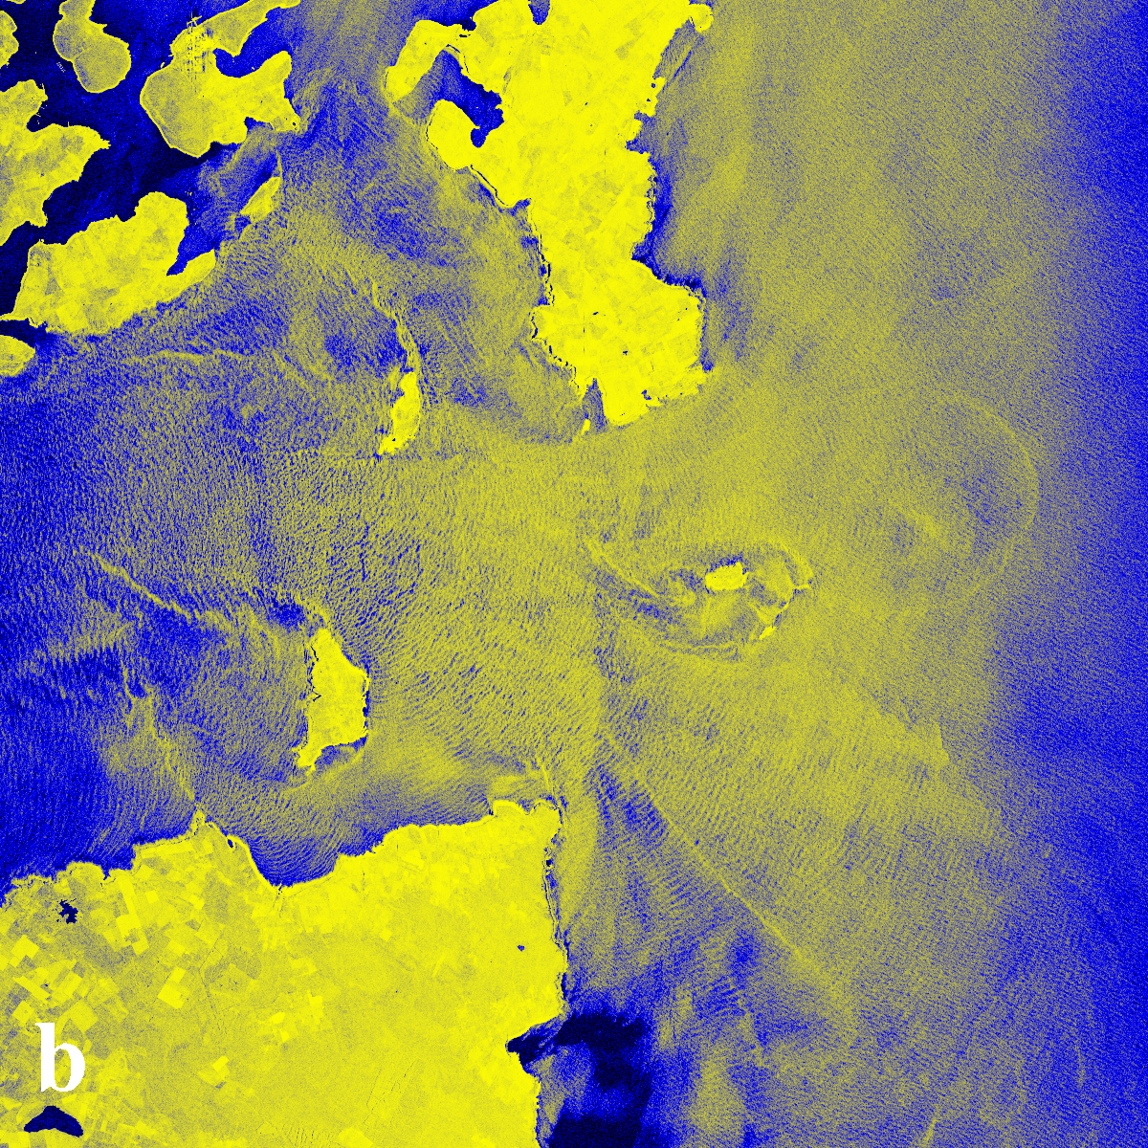
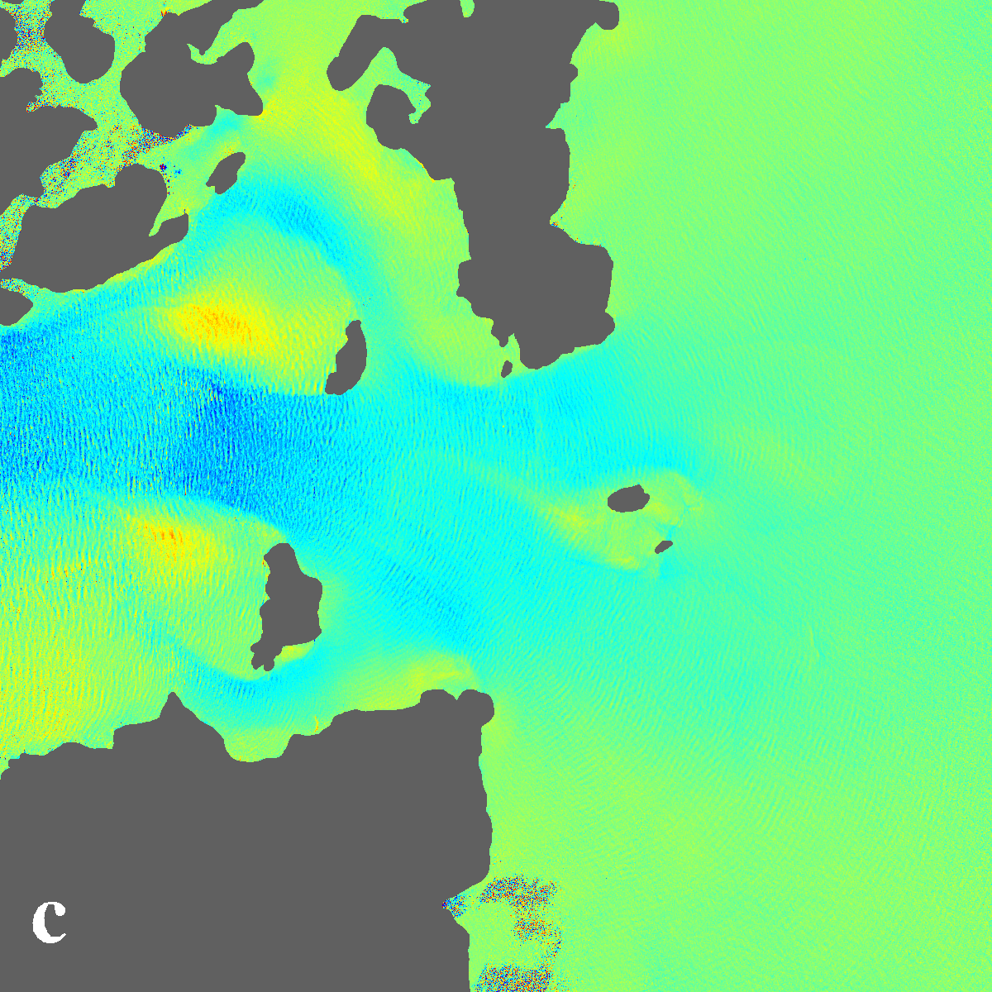
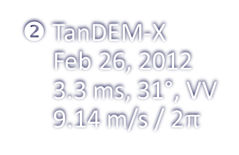
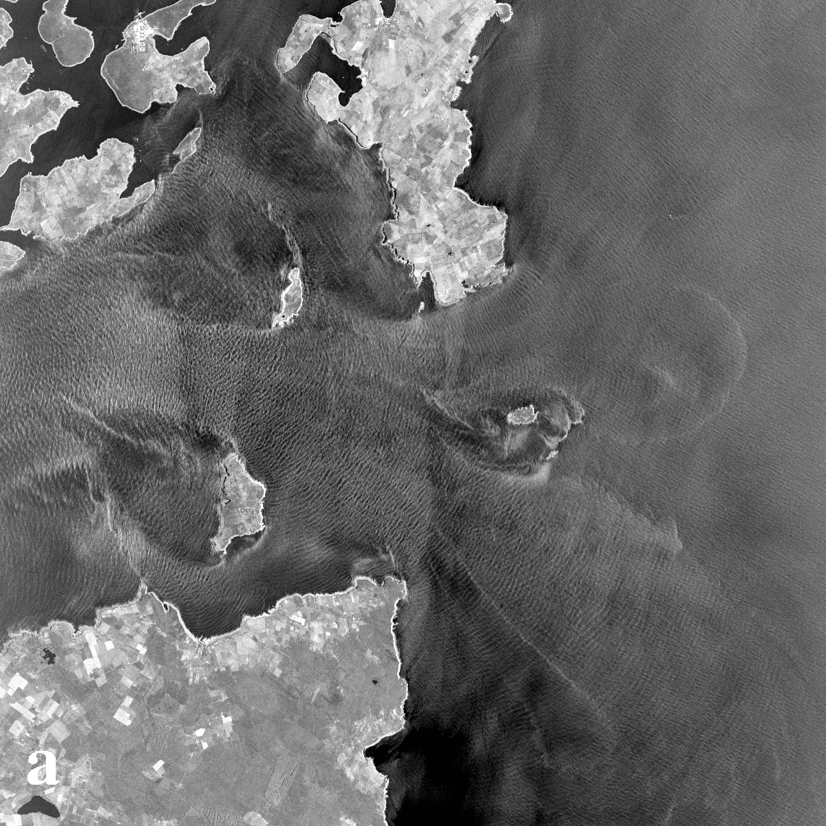
Divided Antenna vs. TanDEM-X – Pentland Firth
Coherence
Doppler Velocity
Amplitude
0 1
–5 [m/s] +5
20 dB Range
❶ TerraSAR-X DRA
Apr 26, 2010
0.15 ms, 31°, HH
200 m/s / 2
❷ TanDEM-X
Feb 26, 2012
3.3 ms, 31°, VV
9.14 m/s / 2
Shown area =
30 km × 30 km;
grid cell size =
25 m × 25 m
Notes:
<numéro>

Slide 8
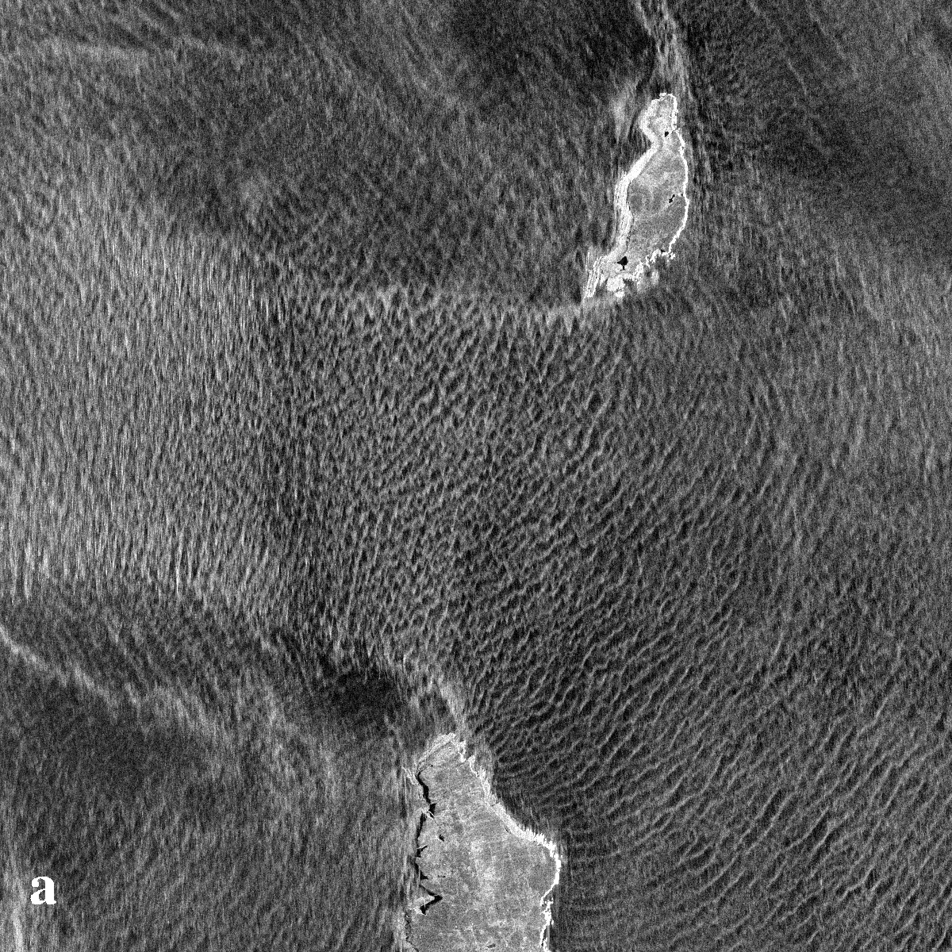
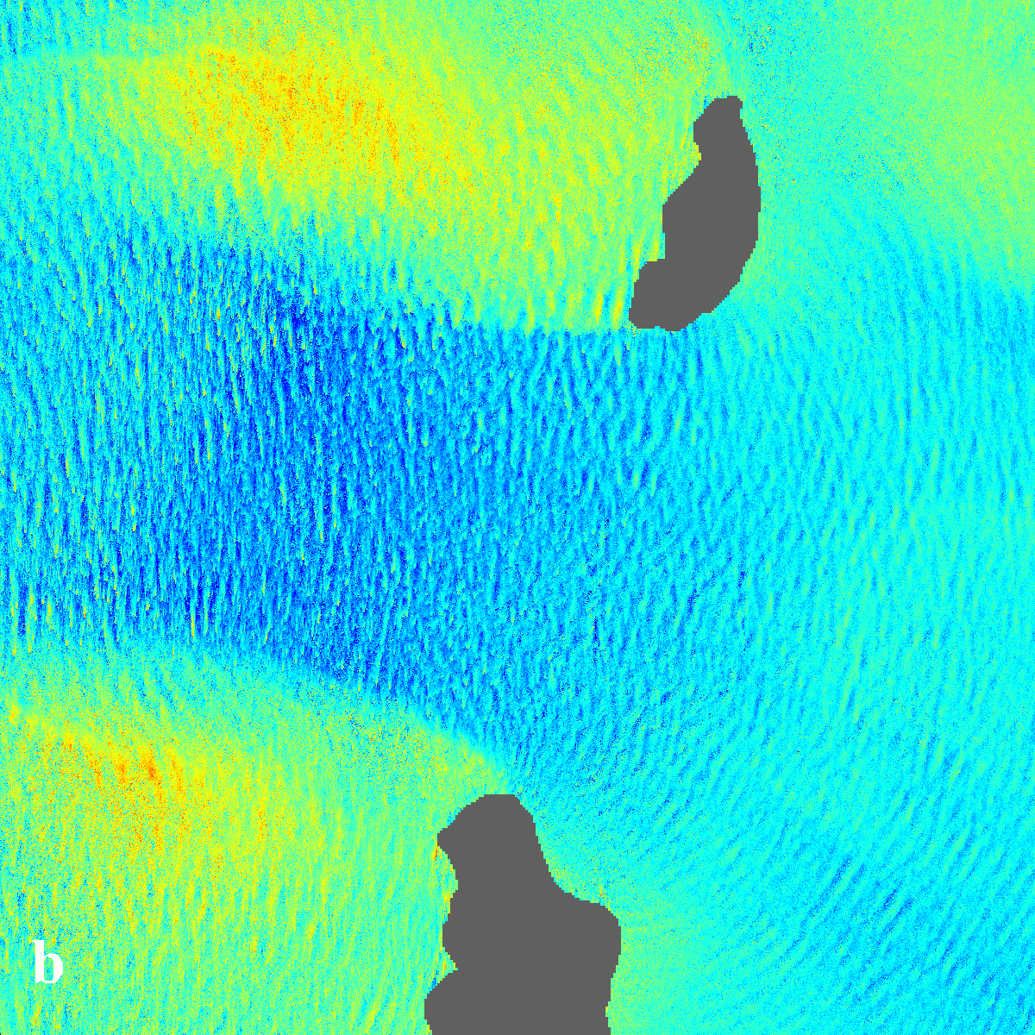
Effective Spatial Resolution of the TanDEM-X Data
20 dB Range
–5 [m/s] +5
Amplitude
Doppler Velocity
10 km × 10 km subsection of the TanDEM-X image
from February 26, 2012; grid cell size = 8.40 m × 8.46 m

Slide 9
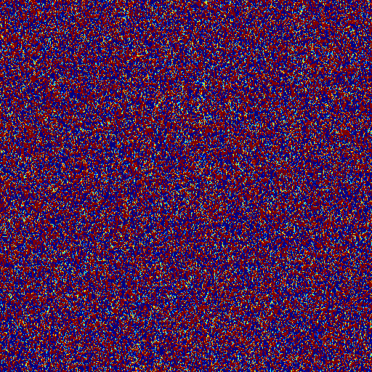
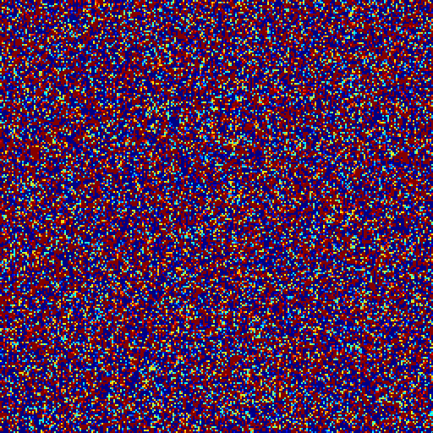
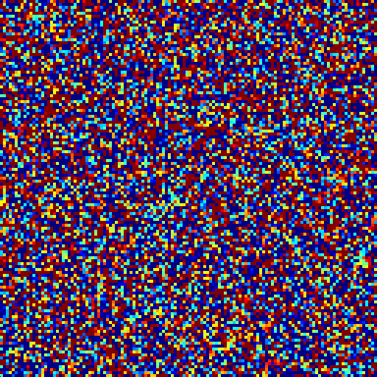
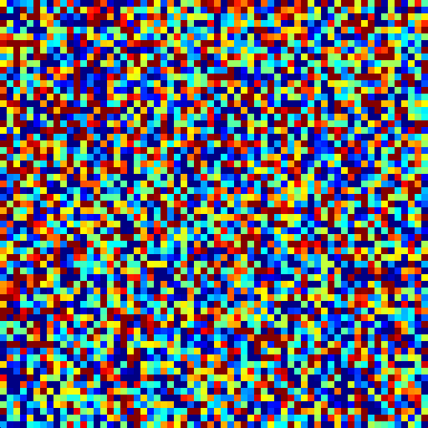
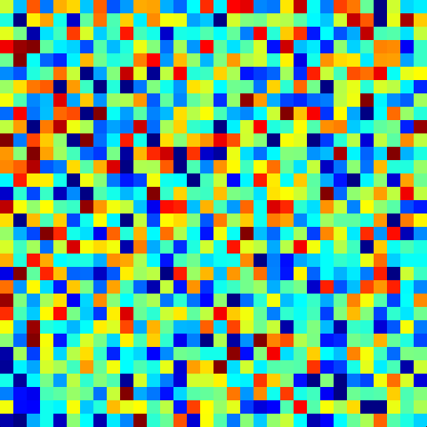
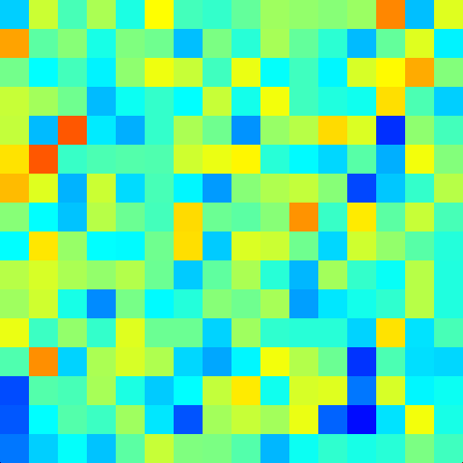









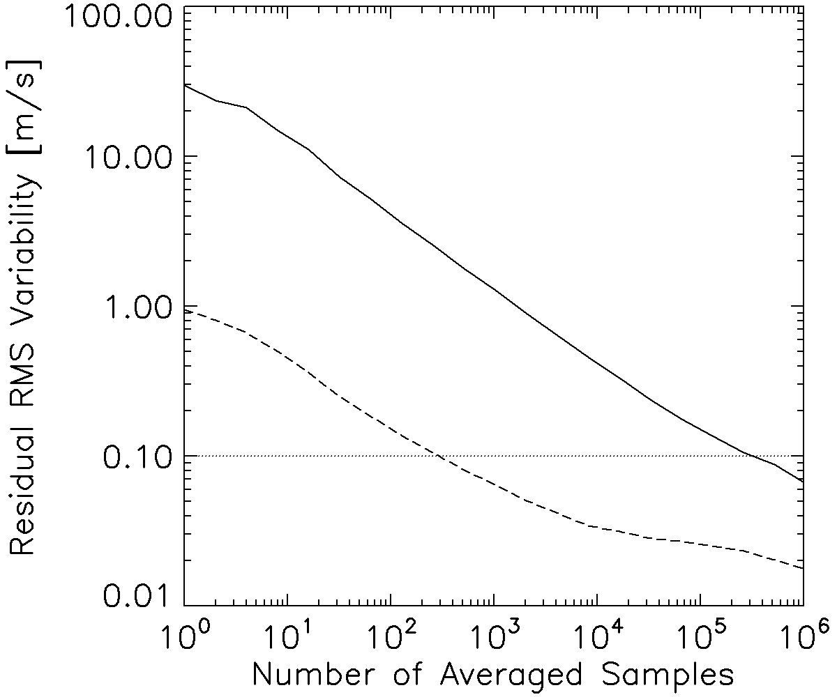
RMS Uncertainty Analysis
TerraSAR-X DRA
TanDEM-X
DRA
33 m
×
33 m
1 km
×
1 km
TanDEM
–5 [m/s] +5
Doppler Velocity

Slide 10
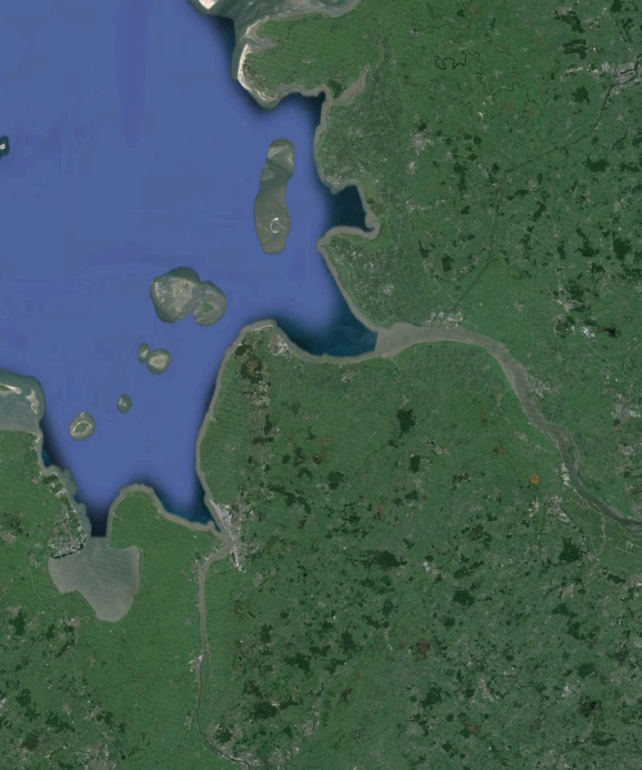
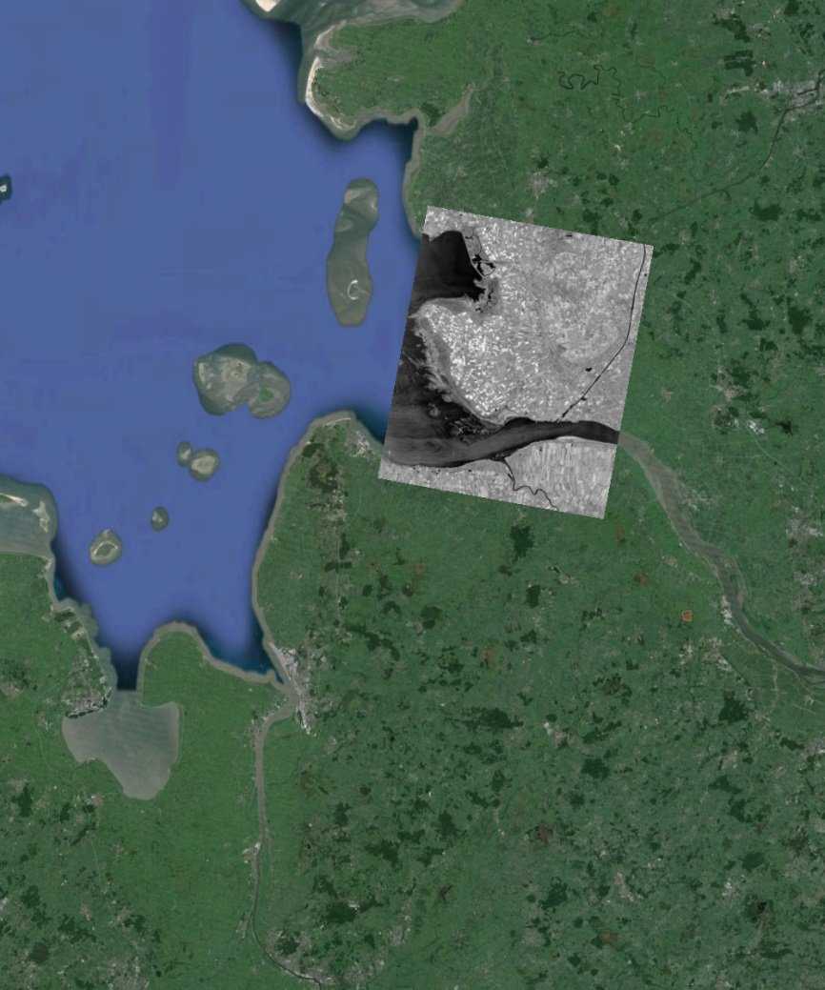
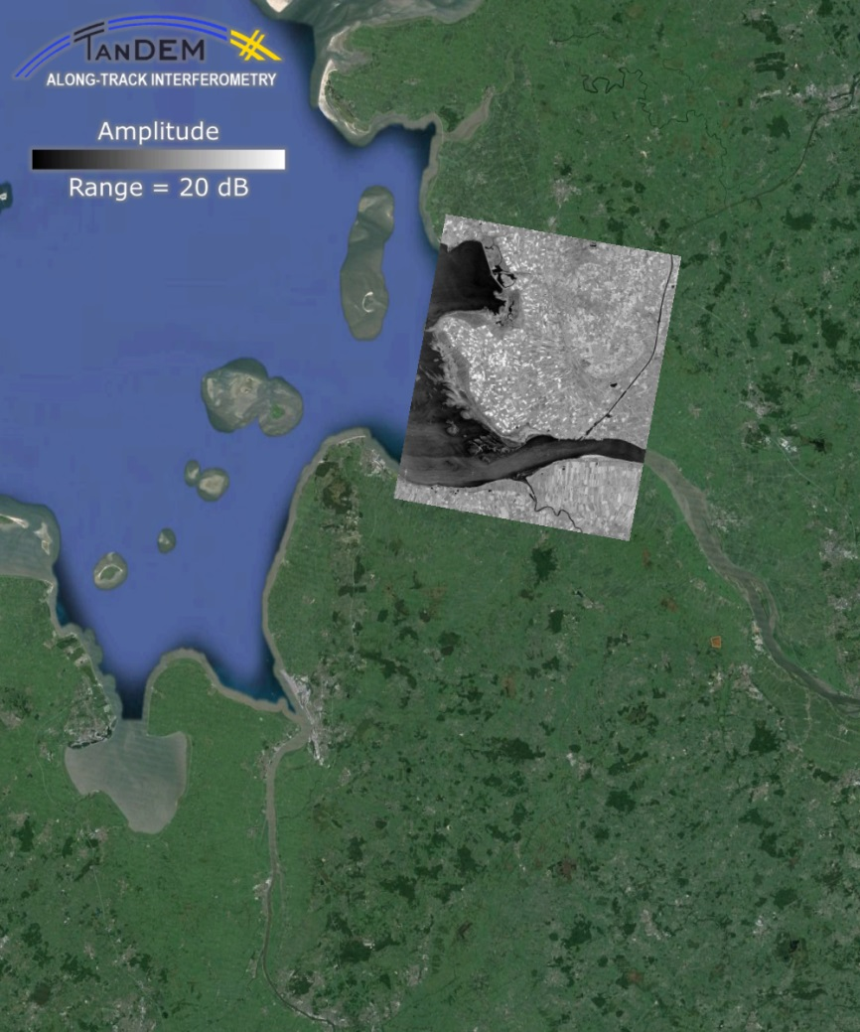
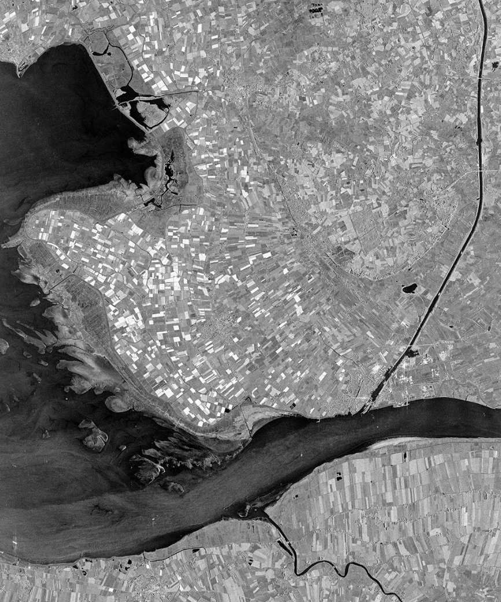
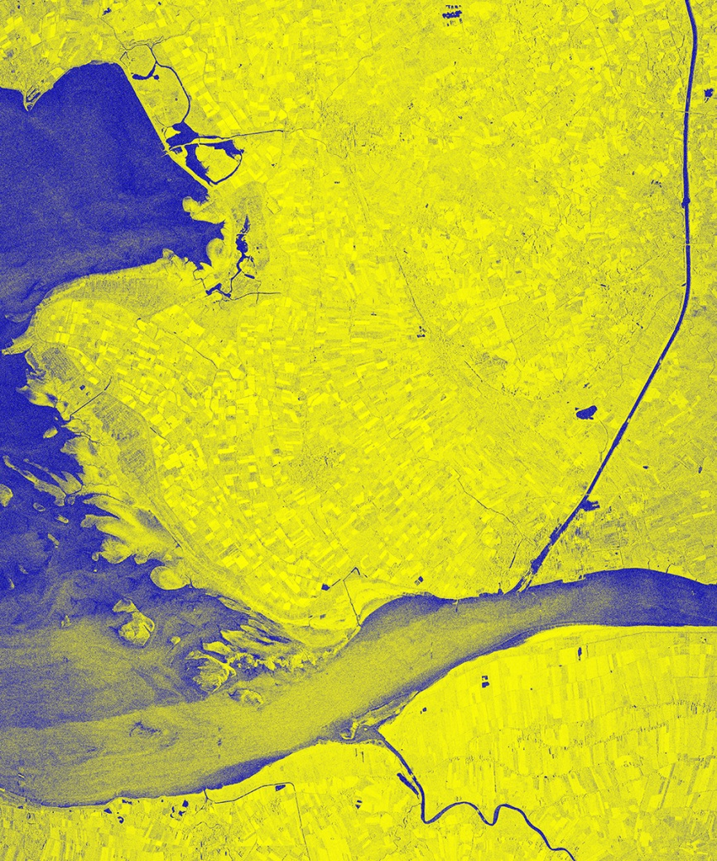
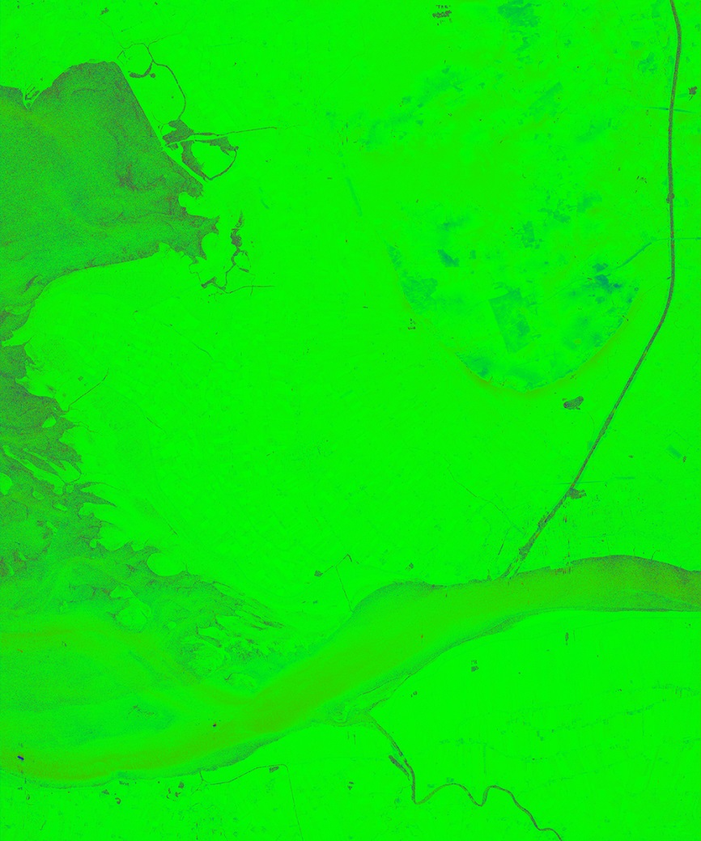
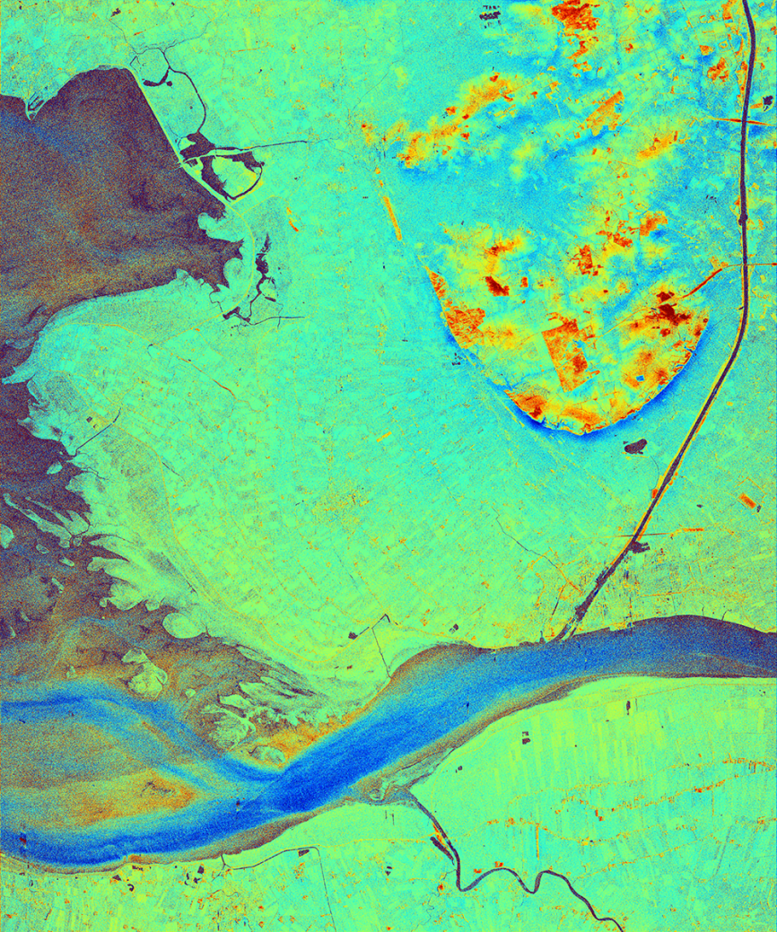
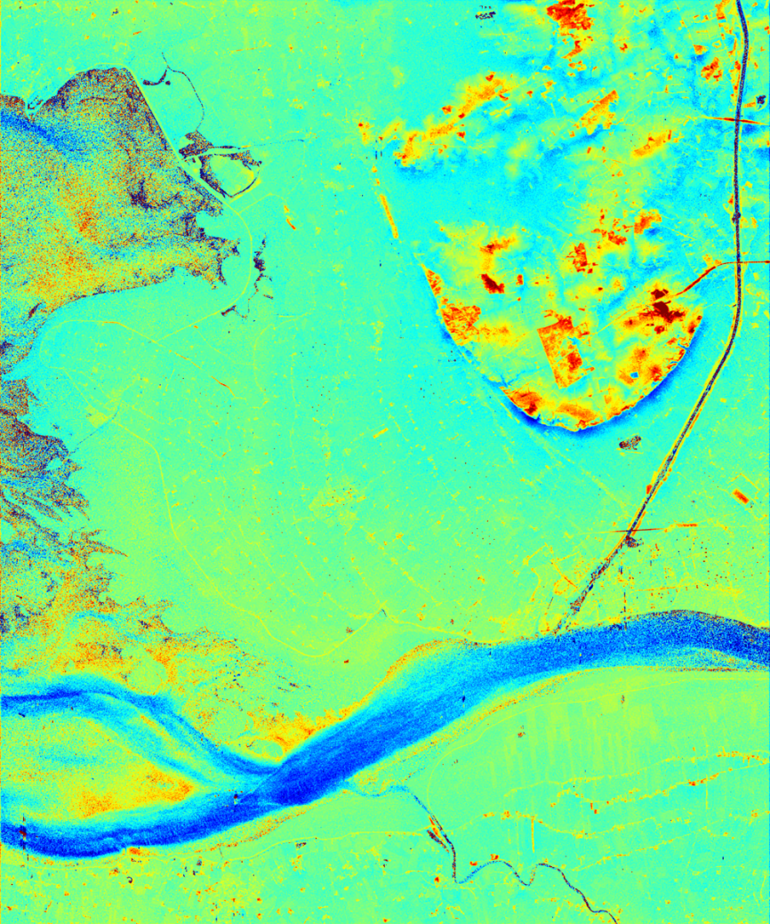

Along-Track Baseline = 12.3 m – Elbe River Mouth
Swath = 33.0 km, grid cell = (7.5 m)²
τ = 1.6 ms, Θ = 38.5°, VV
=> Sensitivity = 15.4 m/s / 2π
Amplitude
Coherence
Phase
Doppler Velocity
0 1
‒ +
20 dB Range
‒2 m/s +2 m/s
Notes:
<numéro>

Slide 11
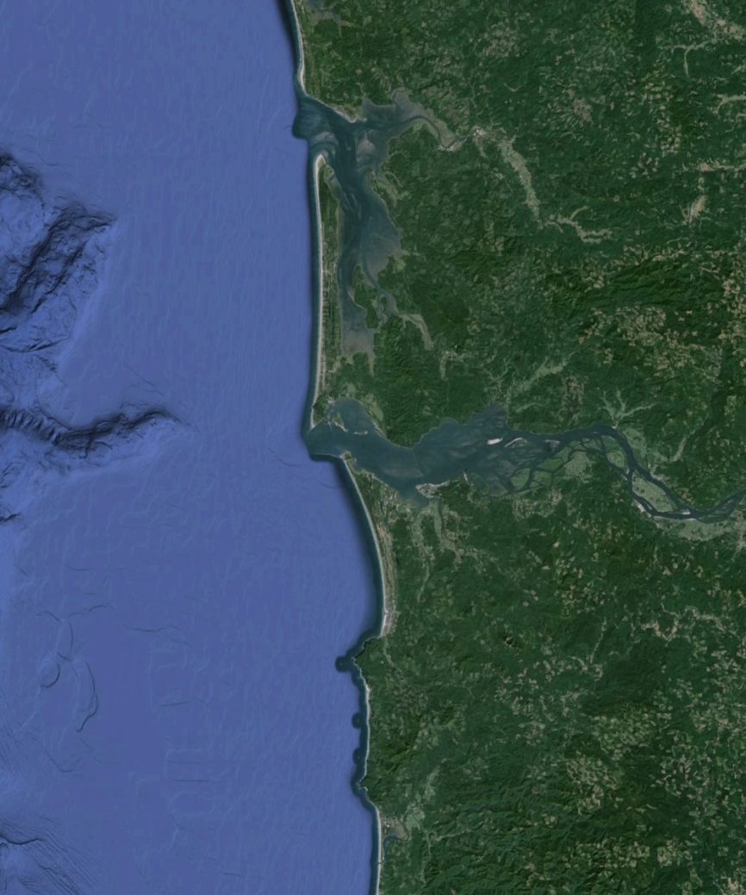
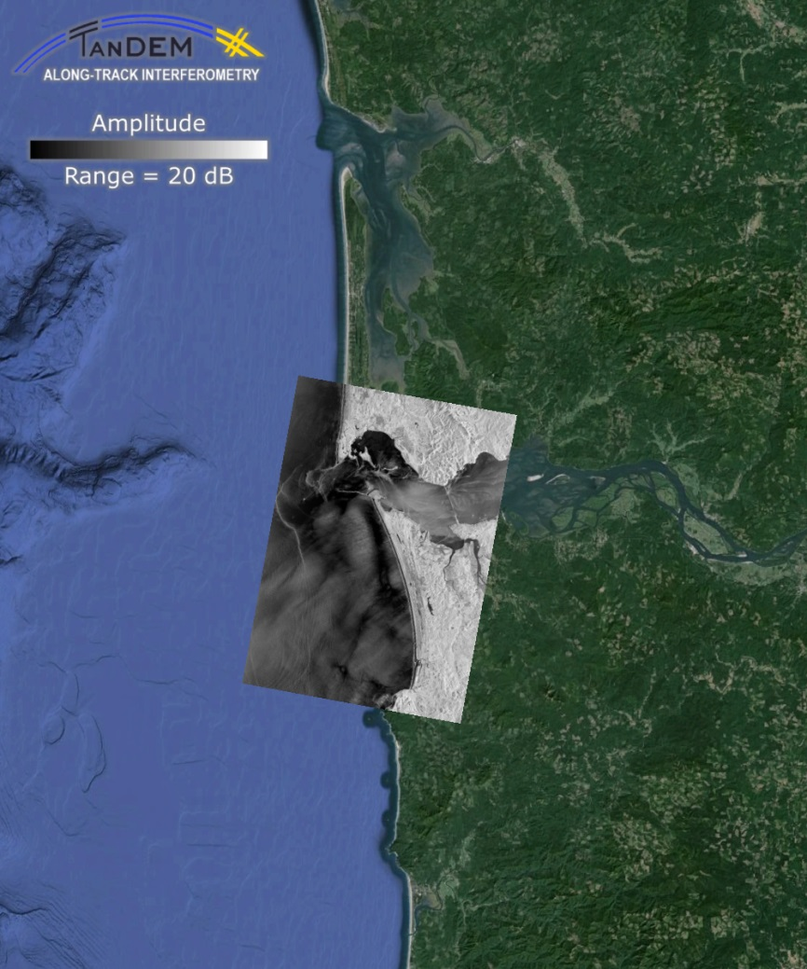
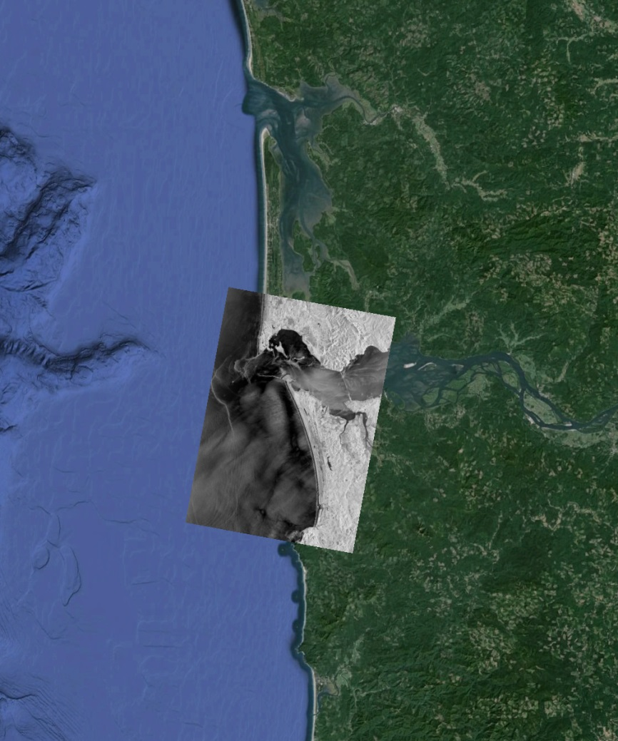
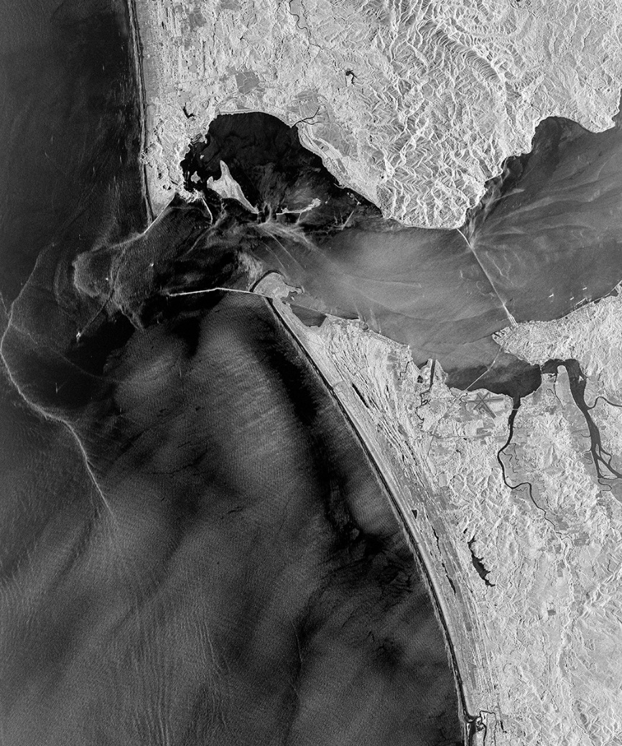
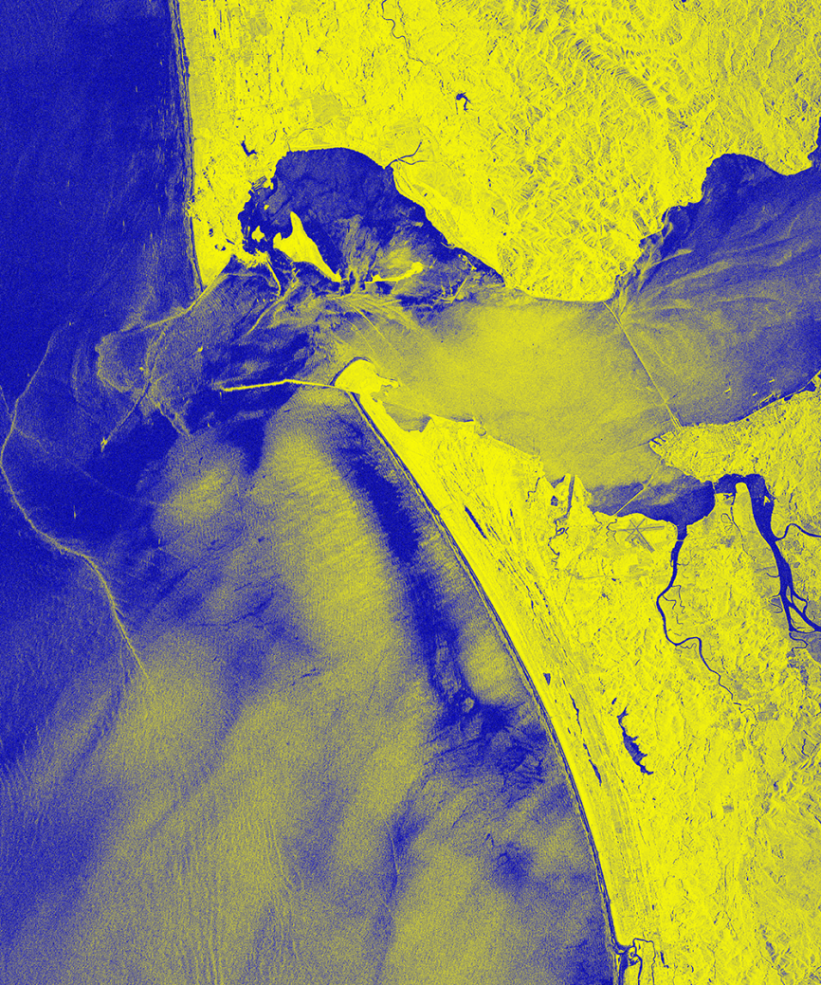
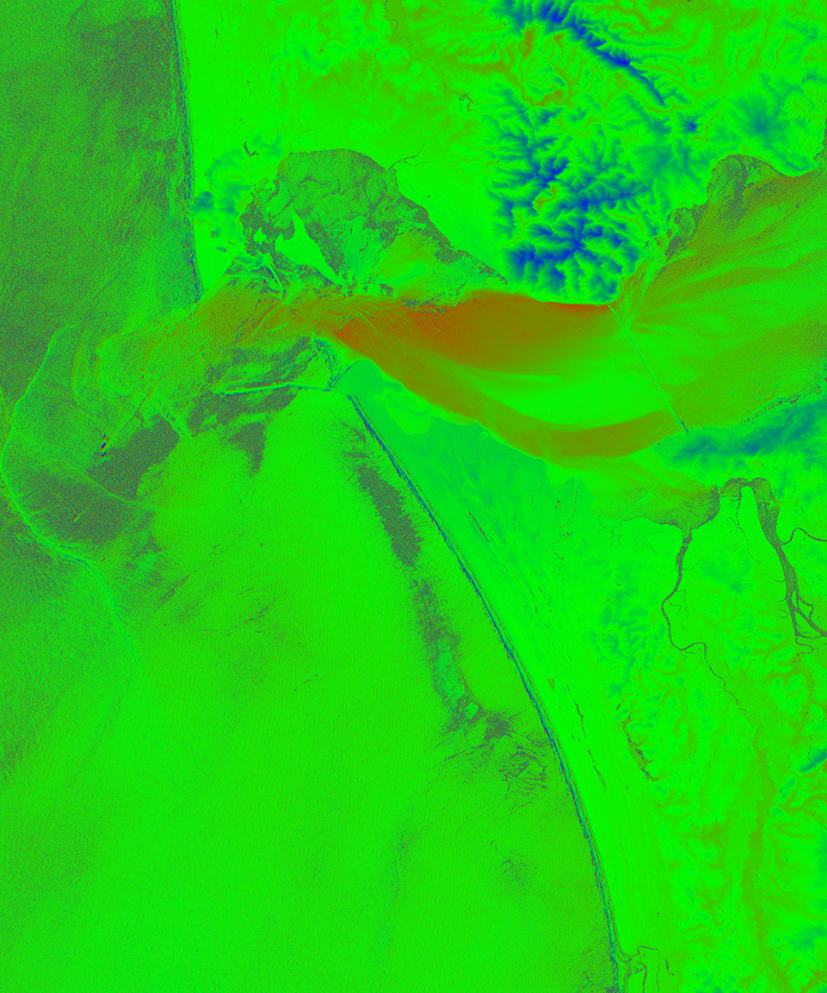
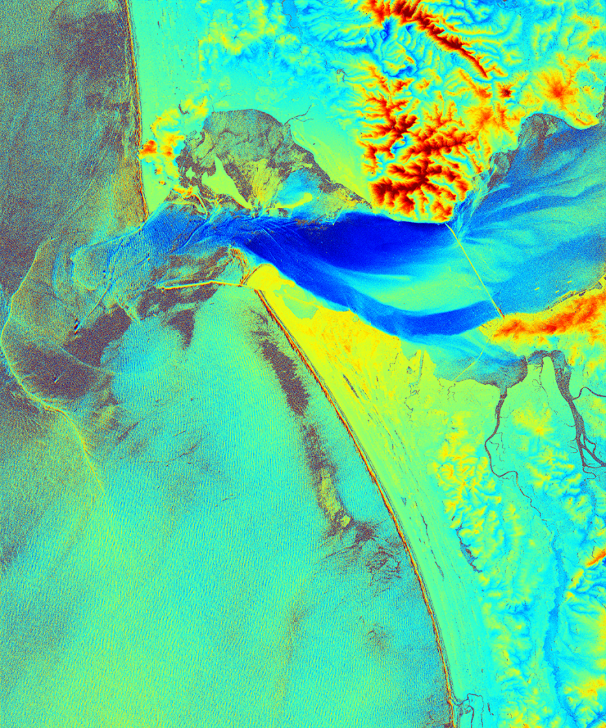
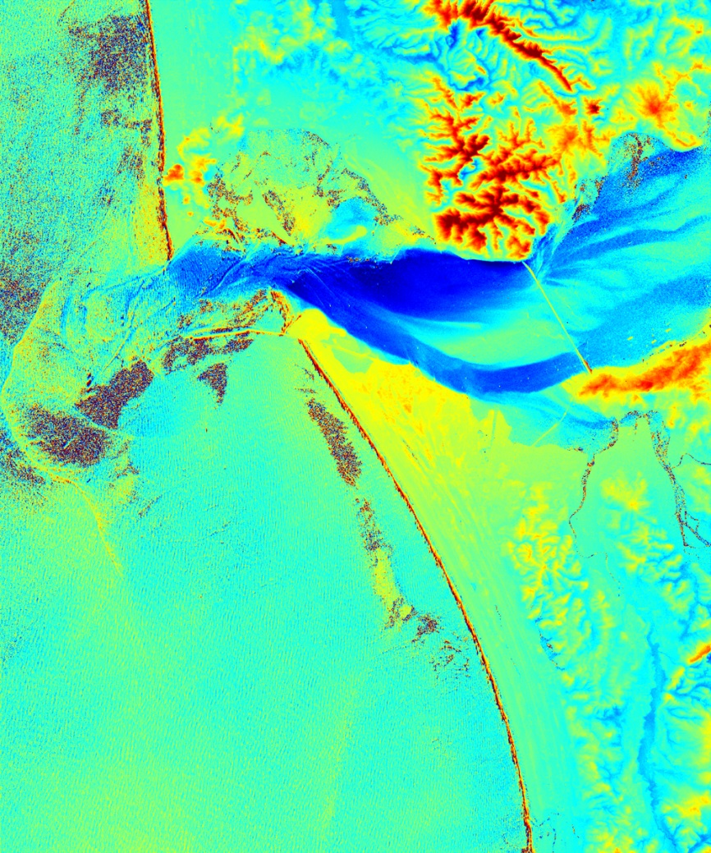
Along-Track Baseline = 34.0 m – Columbia River Mouth
Swath = 32.5 km, grid cell = (7.5 m)²
τ = 4.5 ms, Θ = 34.8°, VV
=> Sensitivity = 6.08 m/s / 2π
Amplitude
Coherence
Phase
Doppler Velocity
0 1
‒ +
20 dB Range
‒2 m/s +2 m/s
Notes:
<numéro>

Slide 12
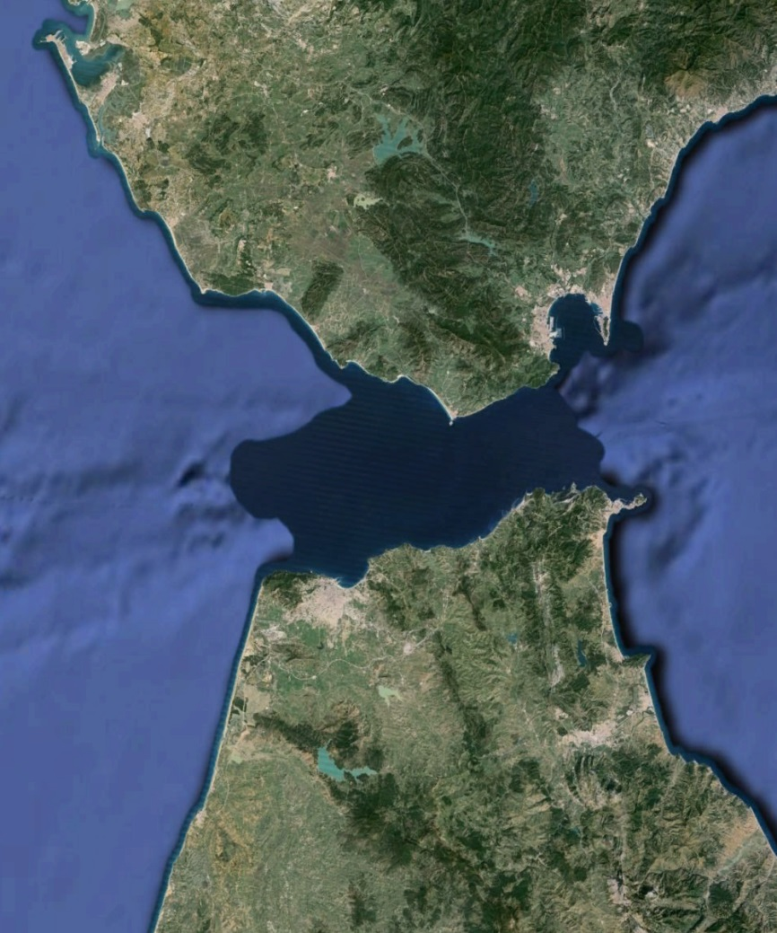
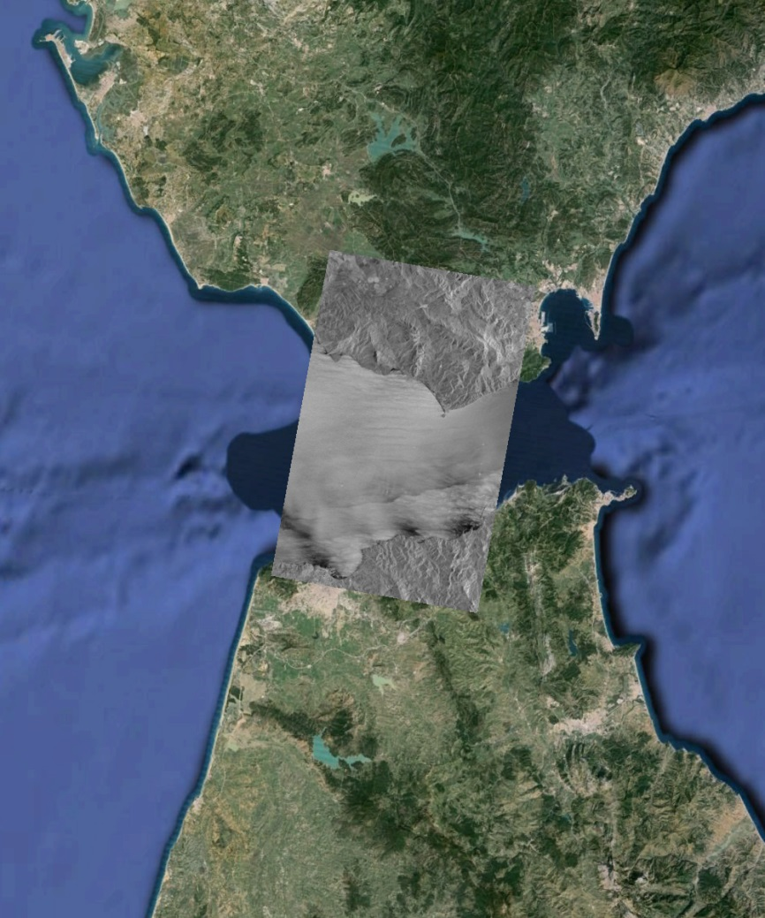
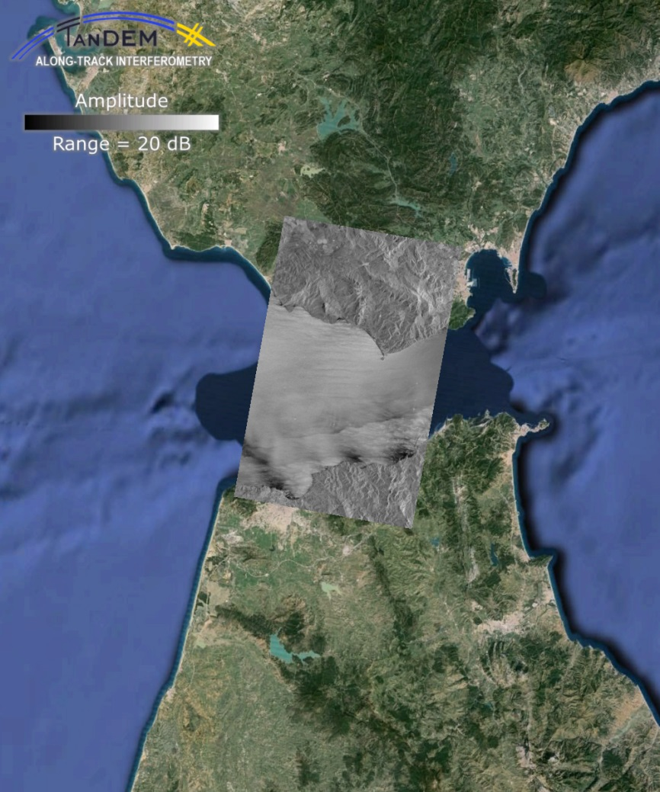
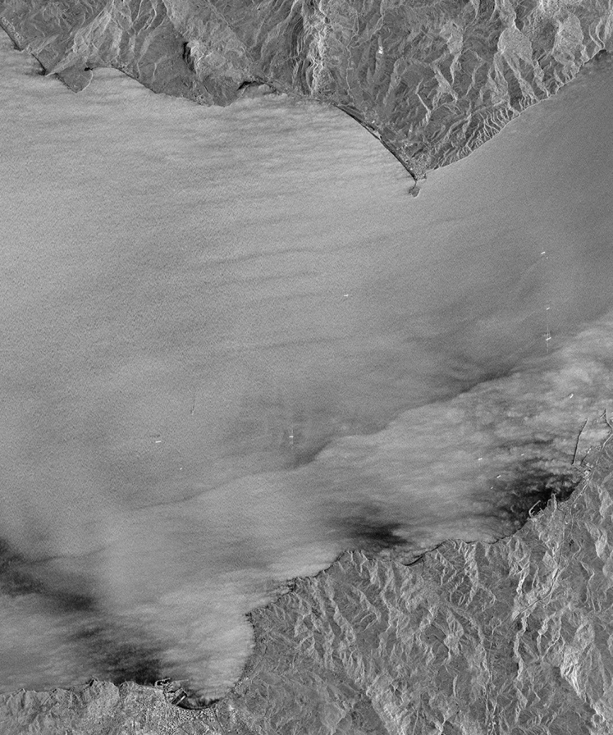




Along-Track Baseline = 49.7 m – Strait of Gibraltar
Swath = 32.7 km, grid cell = (7.5 m)²
τ = 6.5 ms, Θ = 34.8°, VV
=> Sensitivity = 4.16 m/s / 2π
Amplitude
Coherence
Phase
Doppler Velocity
0 1
‒ +
20 dB Range
‒2 m/s +2 m/s
Notes:
<numéro>

Slide 13






















Coherence Experiment – Two TanDEM-X Image Series
<1 due to instrument
noise
>0 due to
finite
sample size
Series 1
2012-03-23
7 images
τ = 1.8-5.4 ms
Θ = 30°
VV
u₁₀ ≈ 5-15 m/s
Series 2
2013-04-18
10 images
τ = 3.0-6.9 ms
Θ = 30°
VV
u₁₀ ≈ 5-10 m/s
Model:
6 m/s
10 m/s
14 m/s

Slide 14
Lessons Learned from Along-Track Interferometry
with SRTM, TerraSAR-X, and TanDEM-X
●
●
●
●
●
●
●
●
●
● Data quality (coherence, effective accuracy and spatial resolution)
consistent with model predictions
● Good results obtained for relatively wide ranges of time lags, incidence angles
● With TanDEM-X, RMS error of 0.1 m/s possible at resolution of about 30 m
● Biggest problems and limitations of TerraSAR-X / TanDEM-X:
● availability for acquisitions with good baseline combinations
● SAR look direction vs. orientation of current features of interest
● instrument noise / SNR, especially at larger incidence angles
● absolute phase calibration
● ghost signatures of bright targets on land (in divided-antenna mode data)
Notes:
<numéro>

Slide 15
New: Resolving Wave Motions with Spotlight-Mode Data
California Coast (Inner Shelf Pilot Experiment), 2015-06-26 14:33 UTC
Area size = 7,600 m × 2,800 m, single-look pixel size = 1.08 m × 0.17 m
TerraSAR-X Staring Spotlight Mode, total SAR integration time = 6.72 s

Slide 16


New: Resolving Wave Motions with Spotlight-Mode Data
SAR Processing Bandwidth
California Coast (Inner Shelf Pilot Experiment), 2015-06-26 14:33 UTC
Area size = 7,600 m × 2,800 m, single-look pixel size = 1.08 m × 0.17 m
TerraSAR-X Staring Spotlight Mode, total SAR integration time = 6.72 s

Slide 17


New: Resolving Wave Motions with Spotlight-Mode Data
SAR Processing Bandwidth
Focus on this
(1024 m)²
window
California Coast (Inner Shelf Pilot Experiment), 2015-06-26 14:33 UTC
Area size = 7,600 m × 2,800 m, single-look pixel size = 1.08 m × 0.17 m
TerraSAR-X Staring Spotlight Mode, total SAR integration time = 6.72 s
Notes:
<numéro>

Slide 18
Series of Subaperture Images Reveals Wave Motions

Slide 19


Series of Subaperture Images Reveals Wave Motions
With proper dispersion shell analysis,
it should be possible to derive
water depths and current vectors
from the moving wave patterns

Slide 20
The Future: SEASTAR
(see Christine Gommenginger's presentation for more)

Slide 21
Strengths and Weaknesses of SEASTAR
●
●
●
●
●
●
●
Strengths
● Produces 1 km resolution vector wind and current fields within a 170 km swath
● Uses well-established along-track InSAR and wind scatterometry techniques
● Synergies with proposed Doppler scatterometers in data interpretation and use
● Single-satellite, stand-alone system does not depend on other satellite missions
Weaknesses
● Limited coverage in space and time
● Not enough support / demand from potential user community at this time
Recommendation
● Launch Doppler scatterometers first, then advertise SEASTAR for complementary
data acquisitions where higher quality is needed
Notes:
<numéro>

Slide 22

Strengths and Weaknesses of SEASTAR
●
●
●
●
●
●
●
Strengths
● Produces 1 km resolution vector wind and current fields within a 170 km swath
● Uses well-established along-track InSAR and wind scatterometry techniques
● Synergies with proposed Doppler scatterometers in data interpretation and use
● Single-satellite, stand-alone system does not depend on other satellite missions
Weaknesses
● Limited coverage in space and time
● Not enough support / demand from potential user community at this time
Recommendation
● Launch Doppler scatterometers first, then advertise SEASTAR for complementary
data acquisitions where higher quality is needed
END OF PRESENTATION
rromeiser@miami.edu
Notes:
<numéro>

